Slide 1

Buildable Digital Health Blueprint
Workshop-1
Context, Background & Use Cases

Slide 2

Workshop plan…
Leverage each successive workshop to progress the development of the blueprint:
Use cases (choosing our initial care pathways)
Digital health specifications (Integration Profiles)
“Lego blocks” (conformant eHealth solutions)
Implementation science (making it “go”)
Each session builds on the one before it…

Slide 3

Workshop-1 Use Cases

Slide 4
Workshop-1 Agenda
Country context
Digital readiness
Burden of disease
Strategic goals
Health system strategy
Digital health strategy
Key question: “what should our HIE do?”
Next steps

Slide 5

How ready are we to implement digital health infrastructure?

Slide 6
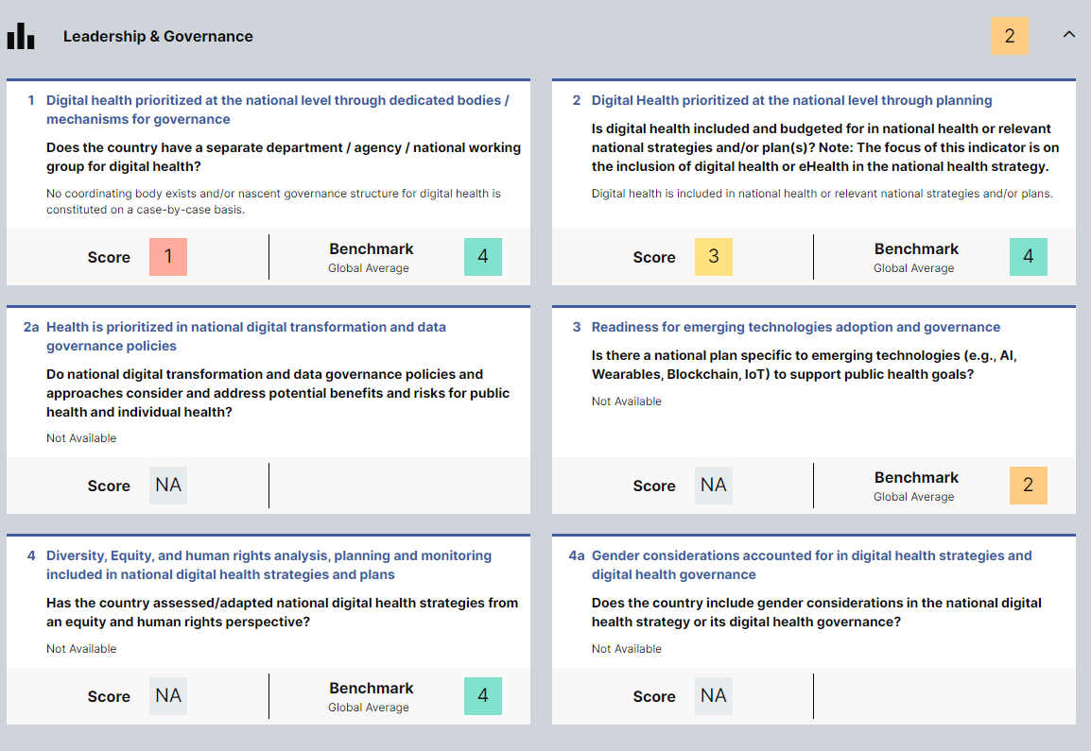
What is the digital readiness?
Notes:
NOTE: GDHM data for Cambodia used. GSMA maps for Rwanda used.

Slide 7
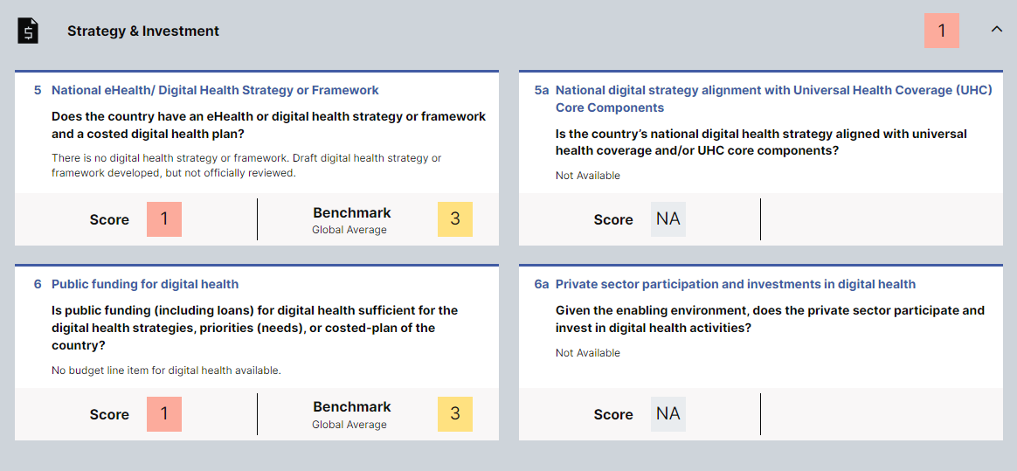
What is the digital readiness?
Notes:
NOTE: GDHM data for Cambodia used. GSMA maps for Rwanda used.

Slide 8
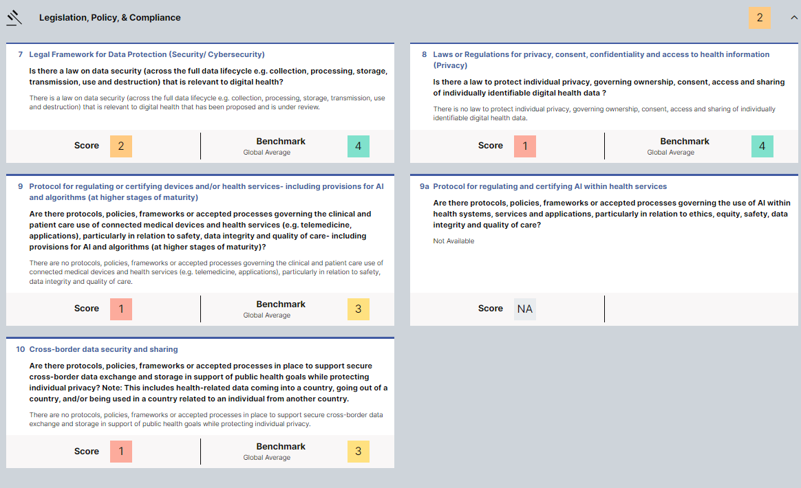
What is the digital readiness?
Notes:
NOTE: GDHM data for Cambodia used. GSMA maps for Rwanda used.

Slide 9
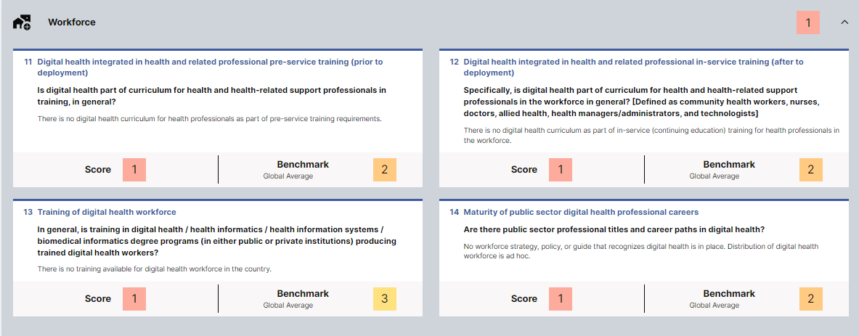
What is the digital readiness?
Notes:
NOTE: GDHM data for Cambodia used. GSMA maps for Rwanda used.

Slide 10
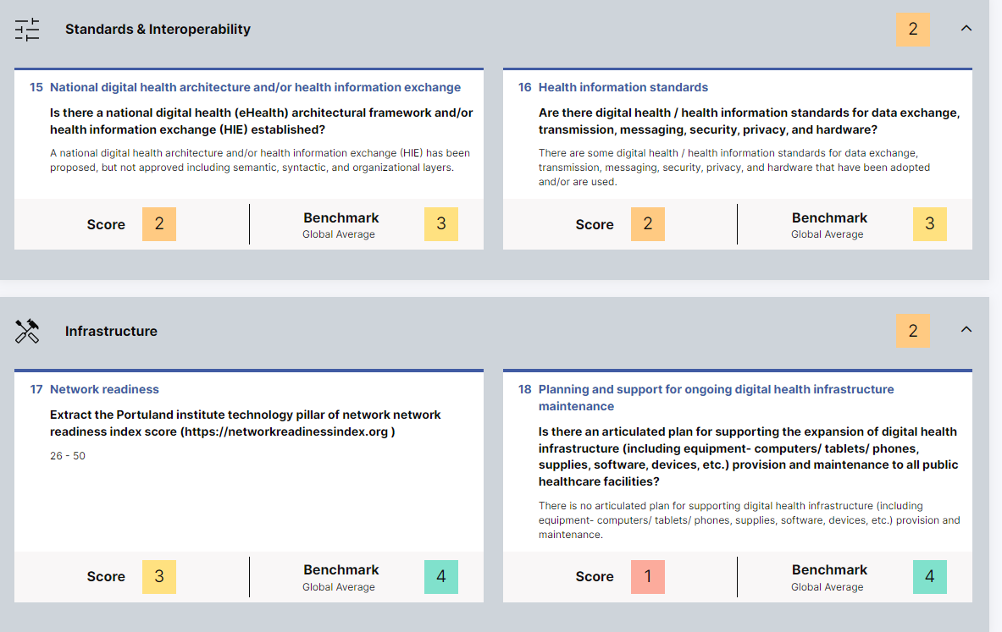
What is the digital readiness?
Notes:
NOTE: GDHM data for Cambodia used. GSMA maps for Rwanda used.

Slide 11
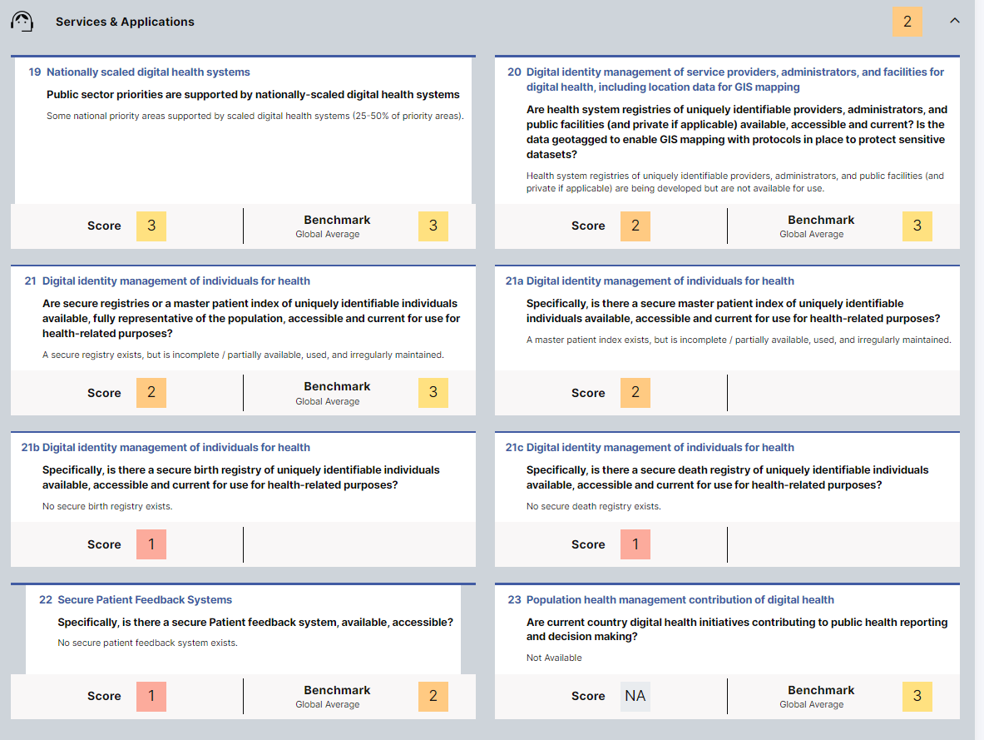
What is the digital readiness?
Notes:
NOTE: GDHM data for Cambodia used. GSMA maps for Rwanda used.

Slide 12
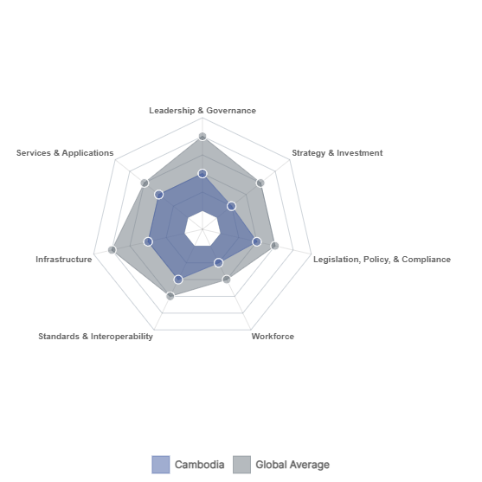
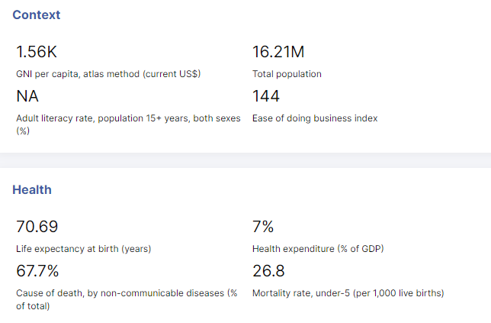
What is the digital readiness?
Country
Notes:
NOTE: GDHM data for Cambodia used. GSMA maps for Rwanda used.

Slide 13
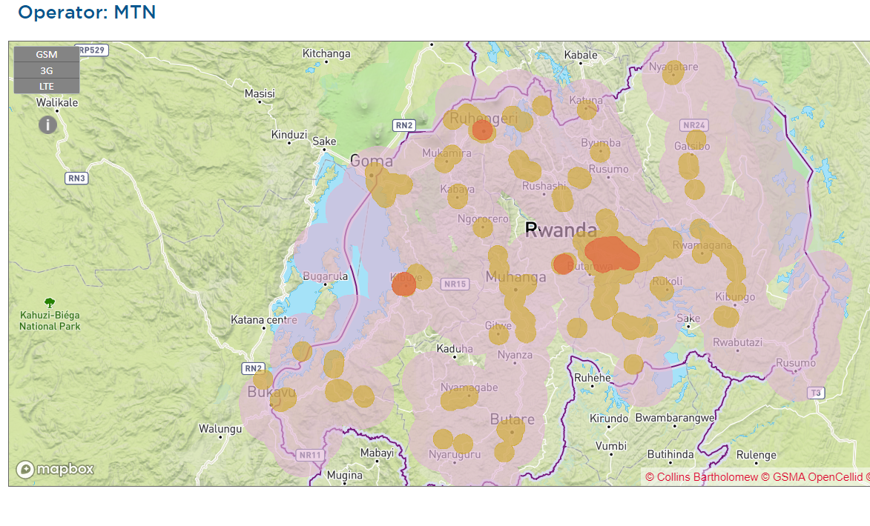
What is the digital readiness?
GSM
3G
LTE
Notes:
NOTE: GDHM data for Cambodia used. GSMA maps for Rwanda used.

Slide 14
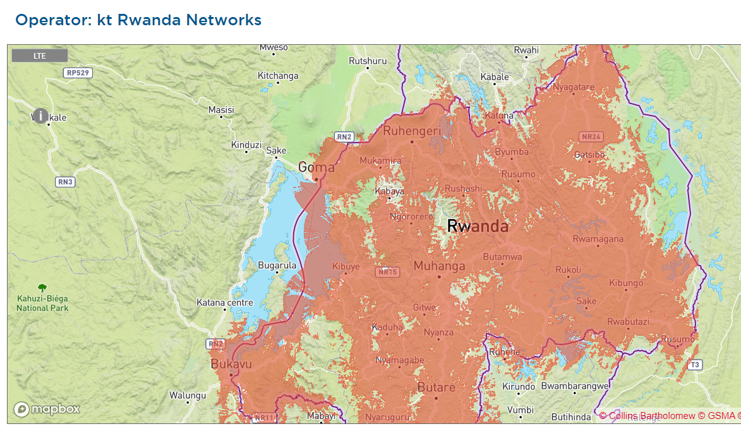
What is the digital readiness?
LTE
Notes:
NOTE: GDHM data for Cambodia used. GSMA maps for Rwanda used.

Slide 15

Key takeaway points:
Amalgaland’s digital readiness is lower than the global average across every axes and most notably lower for the metrics related to:
Leadership & Governance,
Strategy & Investment, and
Infrastructure.
There is good network availability across all main population centres, including strong available of internet-capable (3G and higher) connectivity.

Slide 16


Slide 17

Interaction 1.1
<paste Form link here>
What do you believe are the top 2 challenges impeding digital health adoption? [electricity; network access; hardware availability; software availability and capability; digital literacy; data entry burden; health impact; data privacy; governance; political will; implementation project funding; health worker compensation; other]
What do you believe are the top 2 accelerators for digital health adoption? [electricity; network access; hardware availability; software availability; digital literacy; data entry burden; health impact; data privacy; governance; political will; implementation project funding; health worker compensation; other]

Slide 18
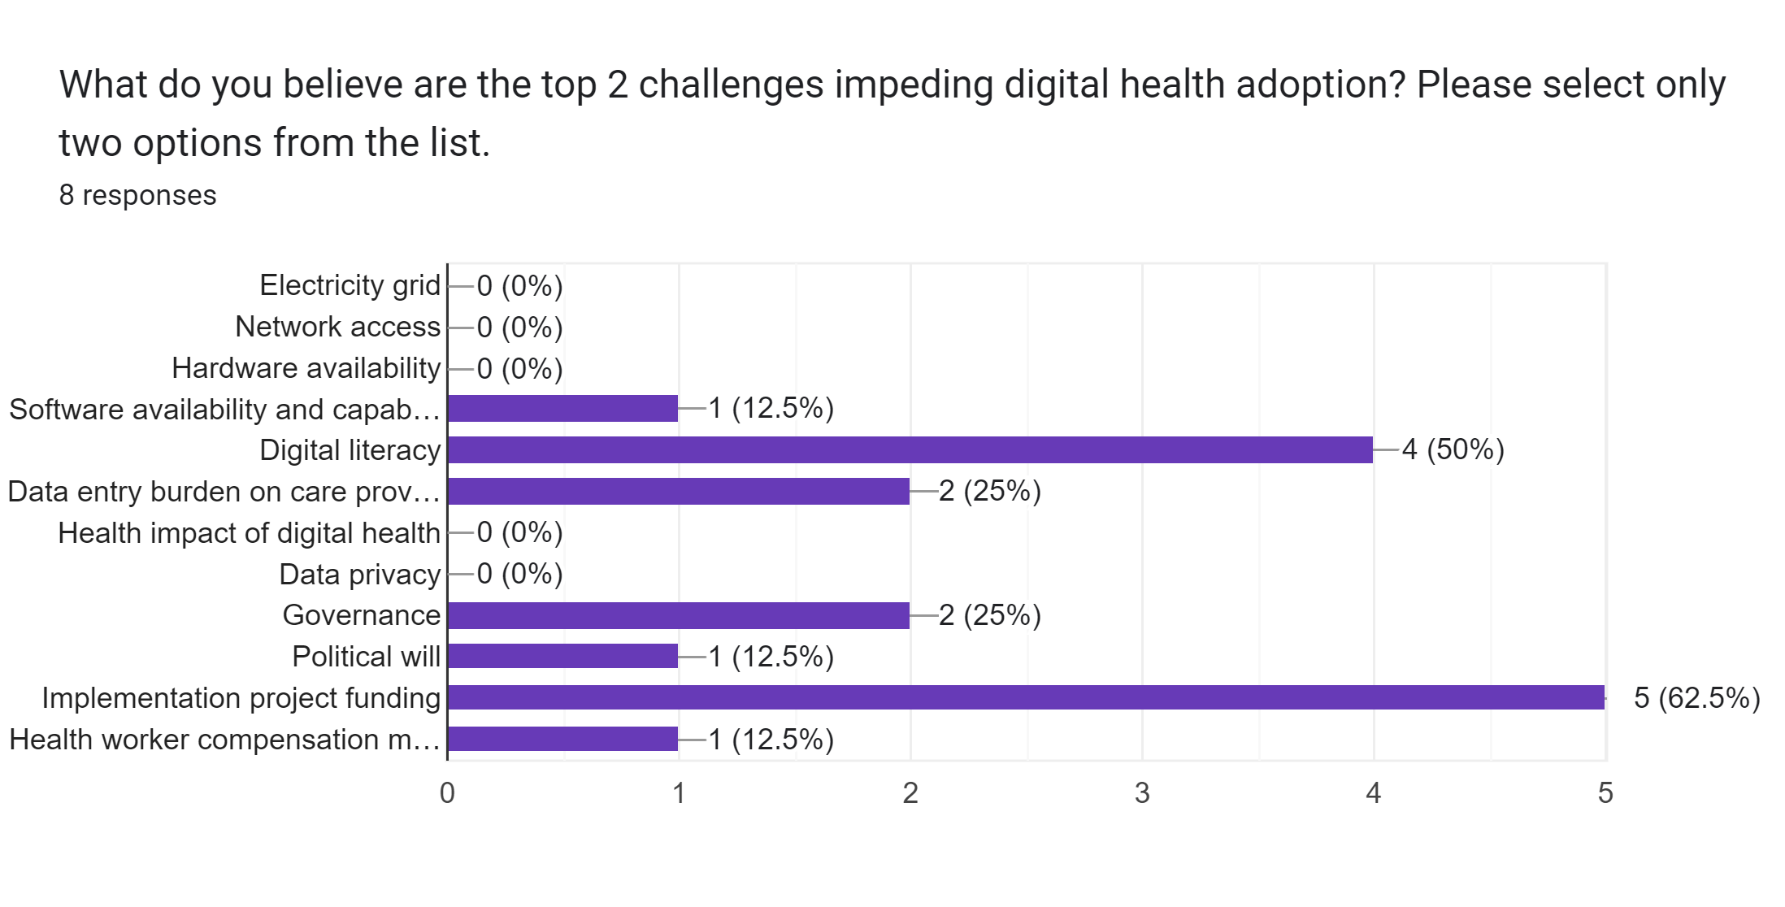
Interaction 1.1

Slide 19
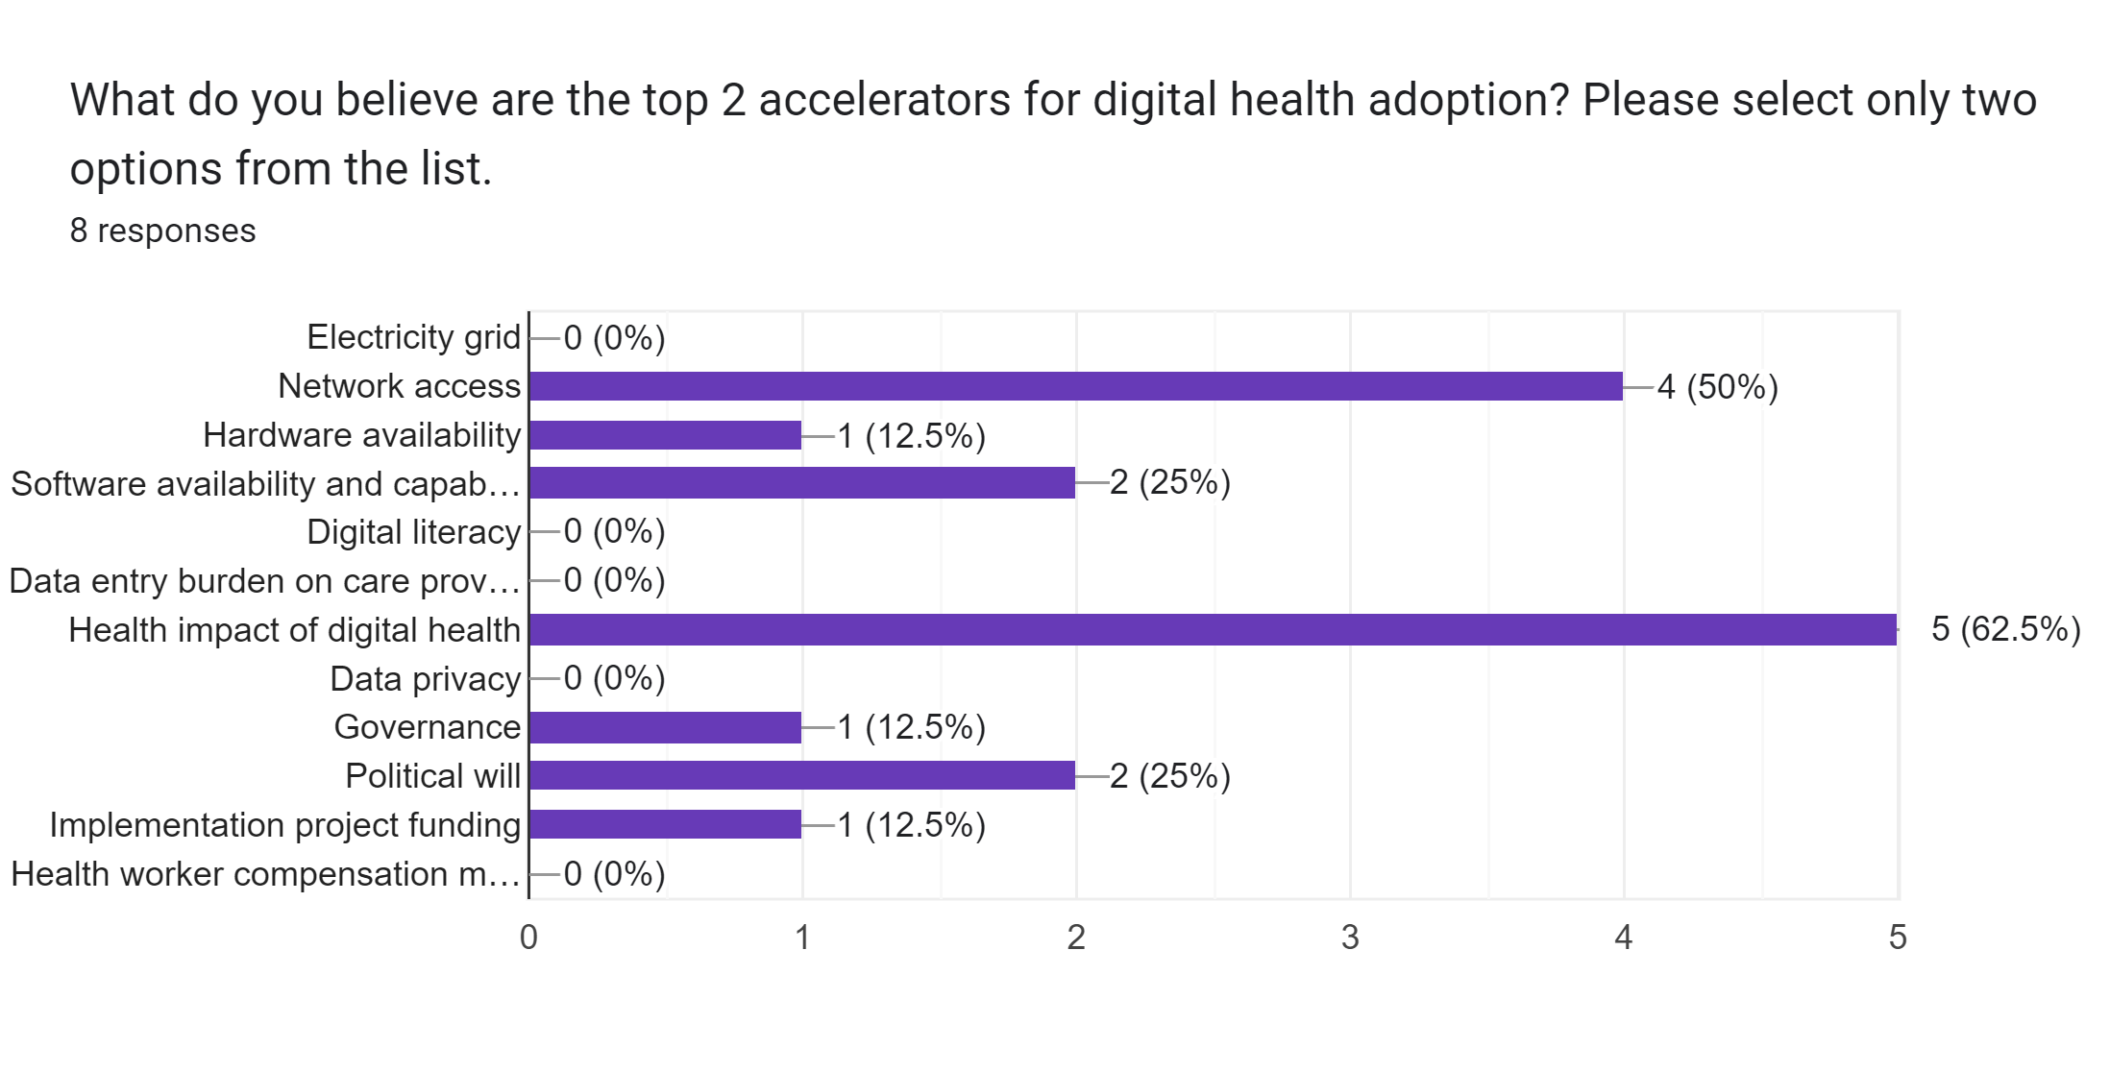
Interaction 1.1

Slide 20
What are our health metrics; what is our current burden of disease?

Slide 21
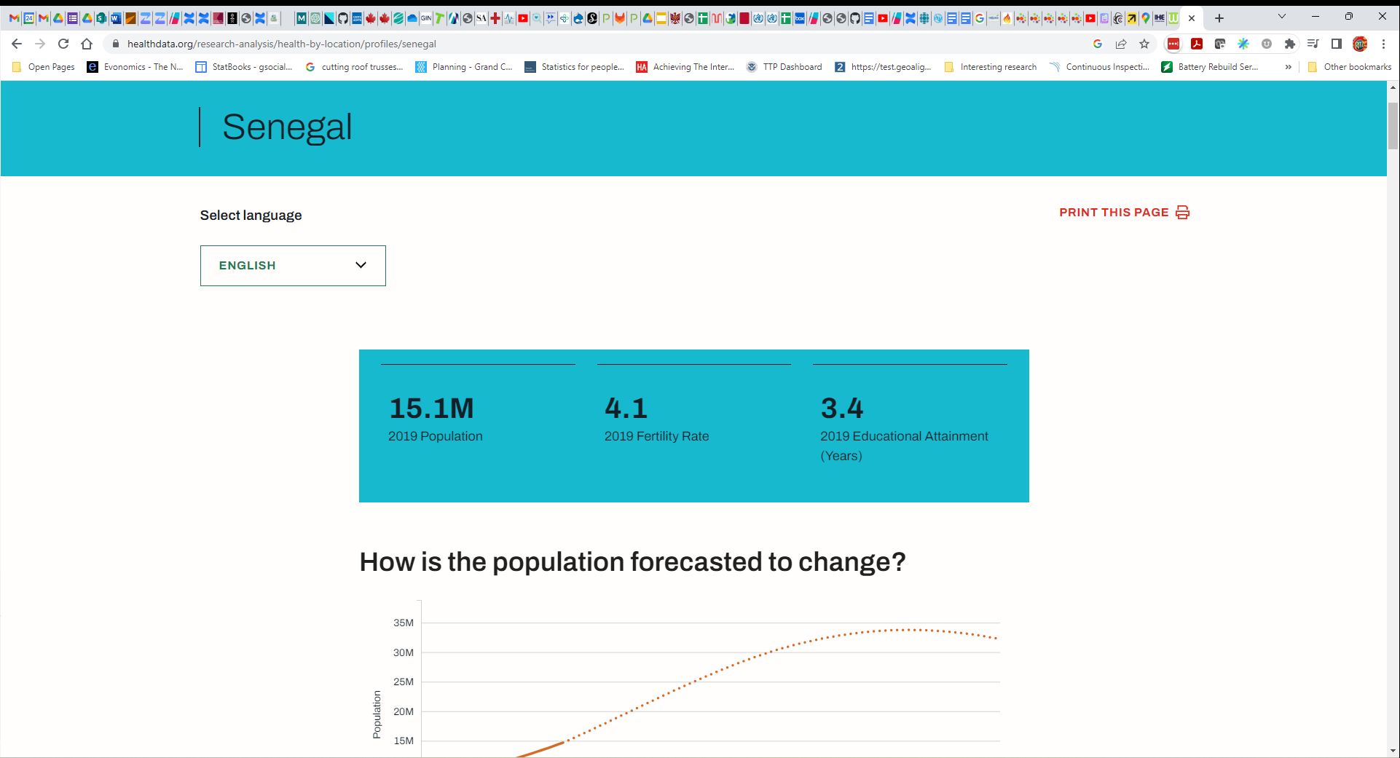
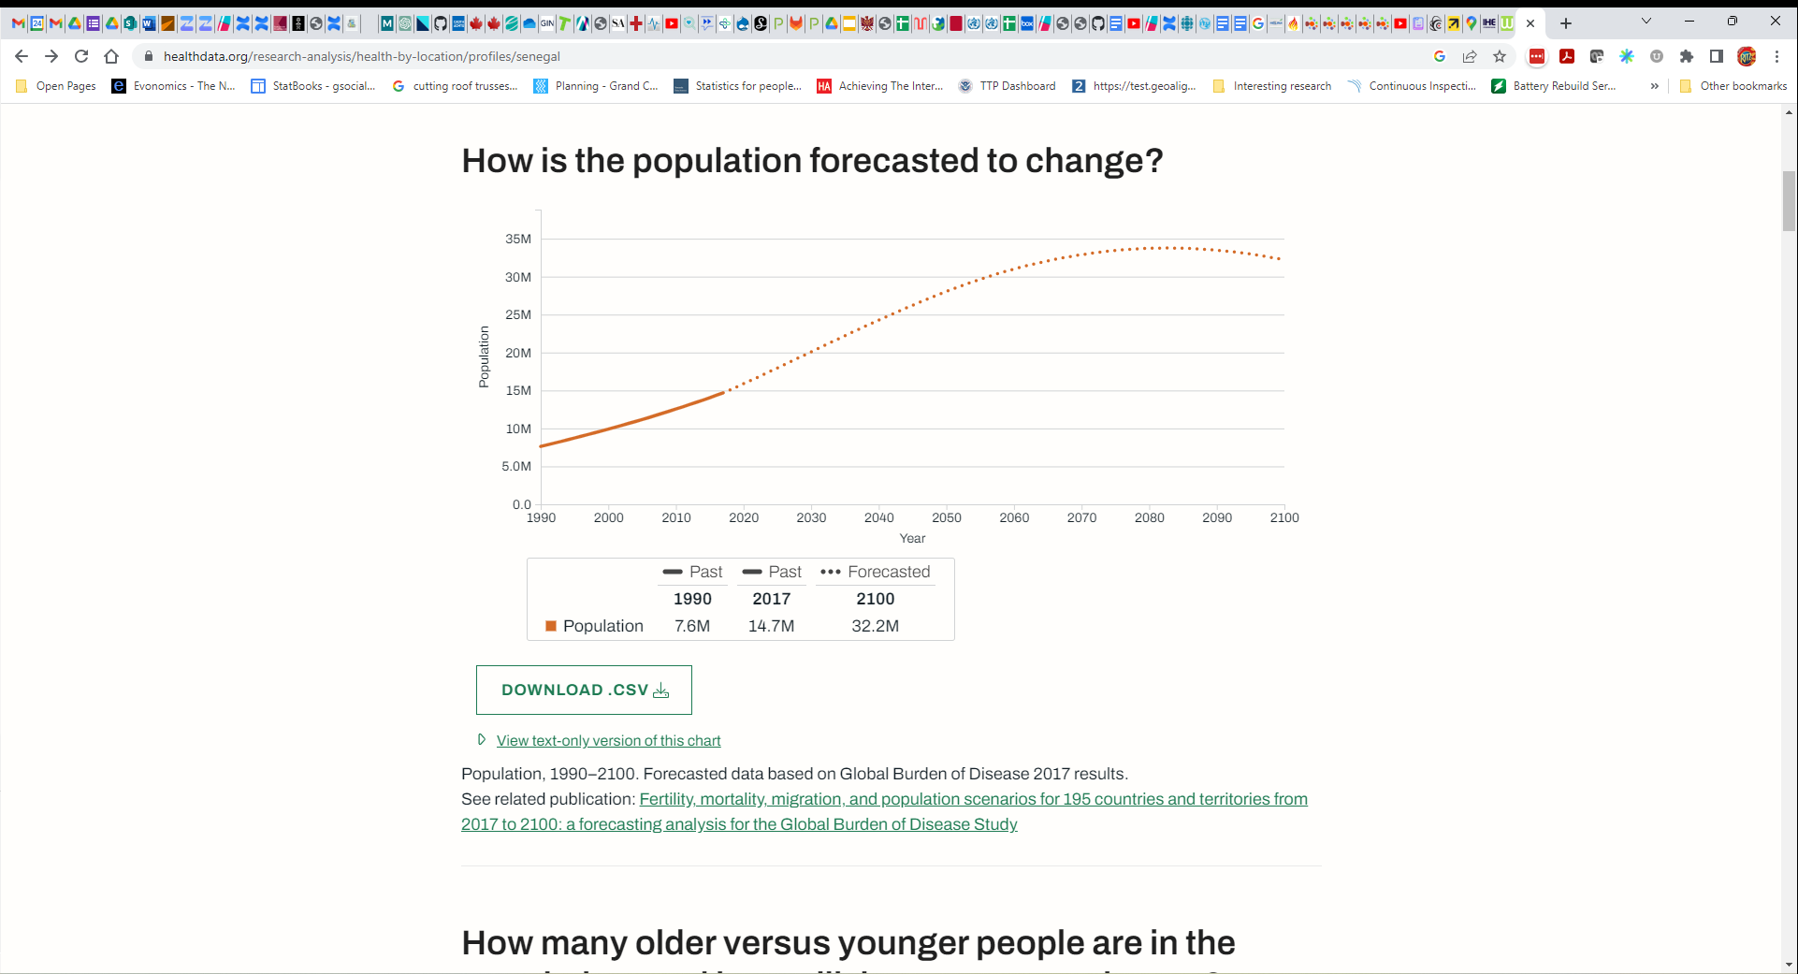
IHME Country Metrics
Doubling in less than 50 years.
Notes:
NOTE: IHME data for Senegal is used for this example

Slide 22
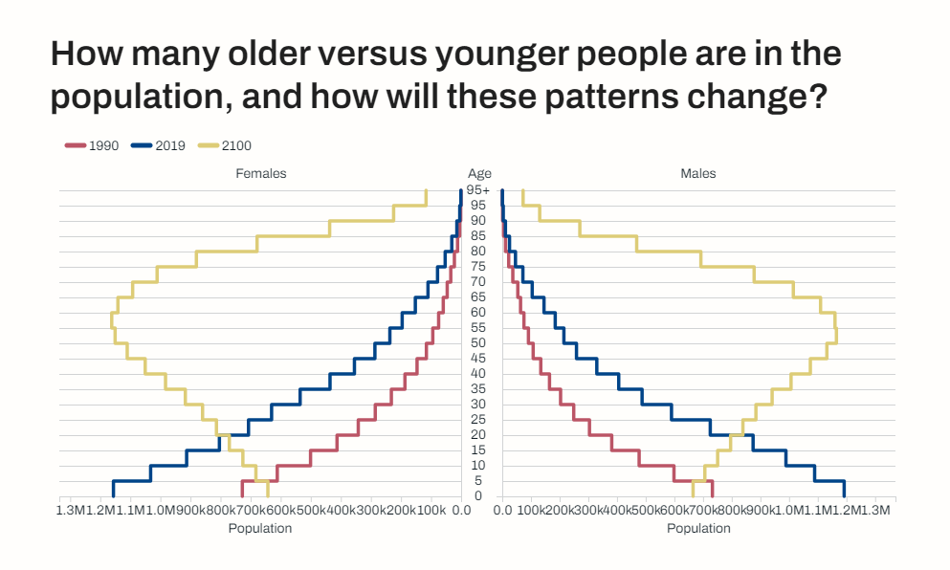
IHME Country Metrics
The “pyramid” becomes a water tower.
Notes:
NOTE: IHME data for Senegal is used for this example

Slide 23
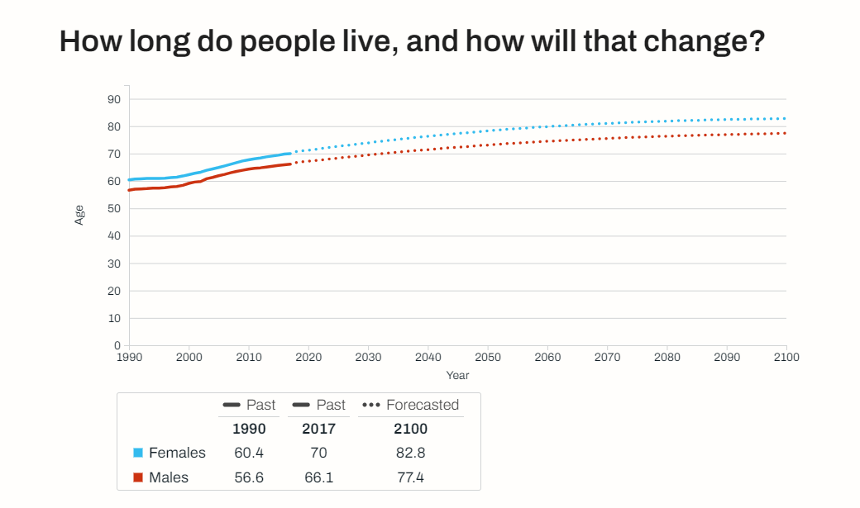
IHME Country Metrics
The “grey tsunami” will increase the NCD burden.
Notes:
NOTE: IHME data for Senegal is used for this example

Slide 24
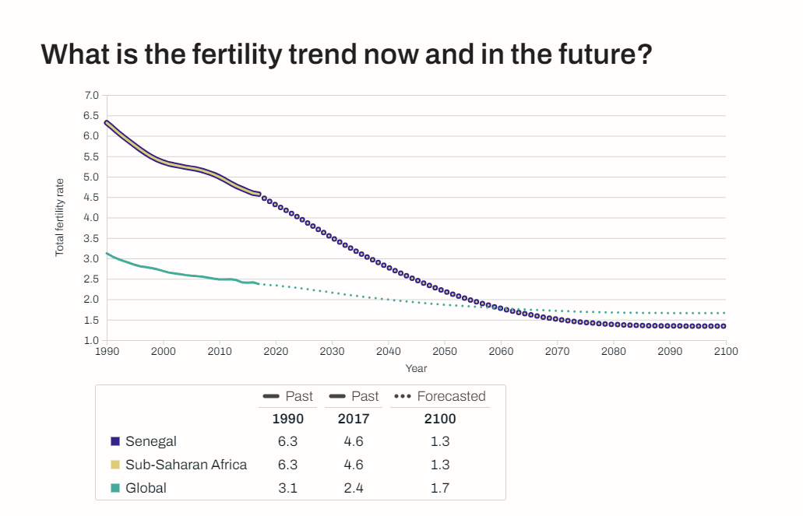
IHME Country Metrics
Steady, sustained downward trend.
Notes:
NOTE: IHME data for Senegal is used for this example

Slide 25
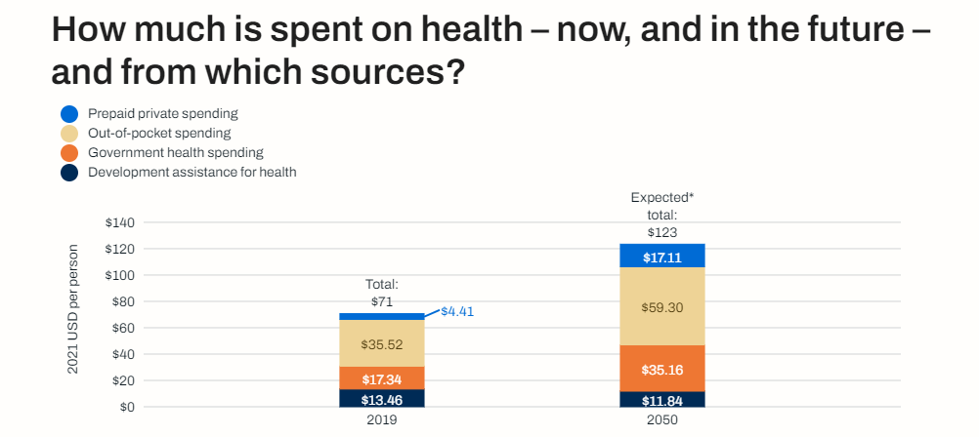
IHME Country Metrics
The proportion of private insurance will increase.
Notes:
NOTE: IHME data for Senegal is used for this example

Slide 26
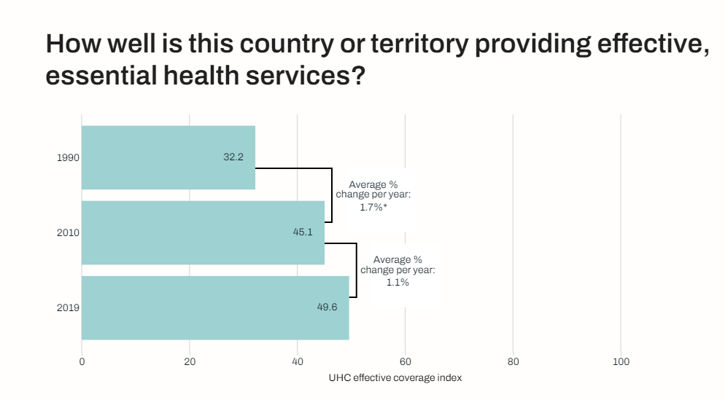
IHME Country Metrics
There is steady progress… and room to improve.
Notes:
NOTE: IHME data for Senegal is used for this example

Slide 27
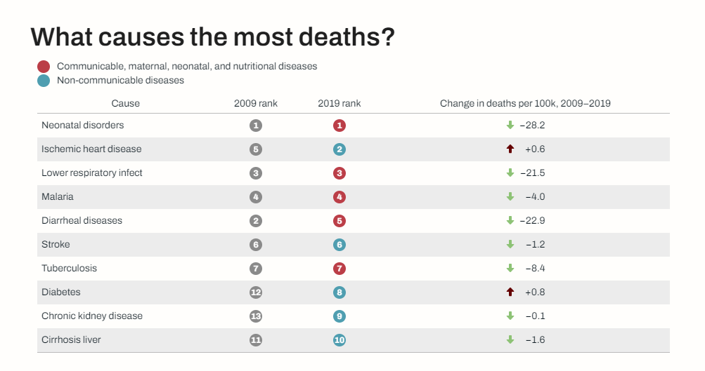
IHME Country Metrics
5 of 10 are NCDs.
Notes:
NOTE: IHME data for Senegal is used for this example

Slide 28
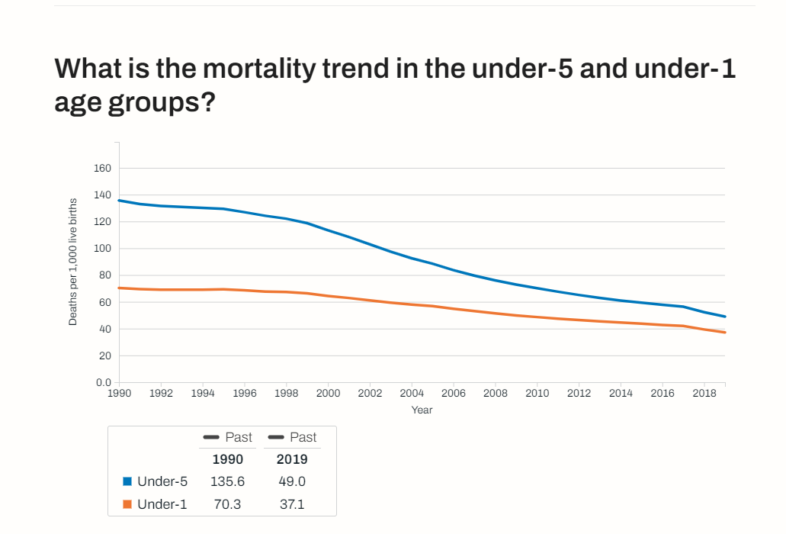
IHME Country Metrics
Steady, long-term progress, with room to improve.
Notes:
NOTE: IHME data for Senegal is used for this example

Slide 29


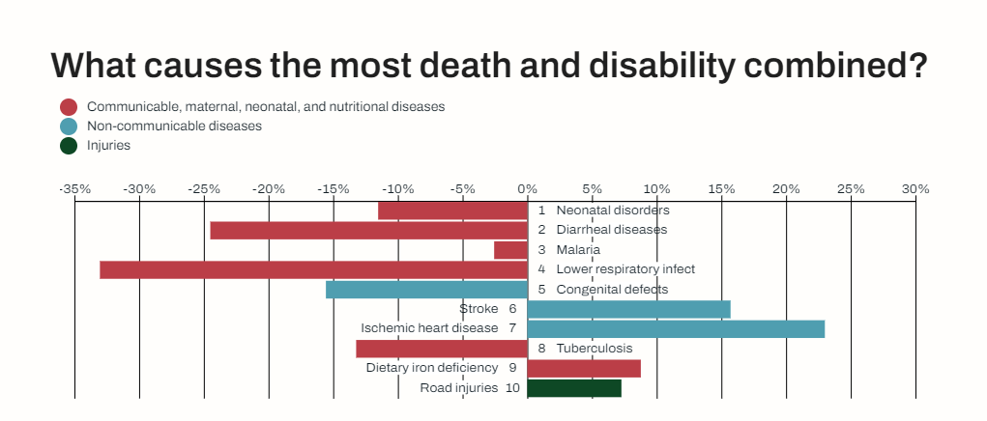
IHME Country Metrics
The NCD burden is increasing.
Great progress on reducing the overall burden.
Notes:
NOTE: IHME data for Senegal is used for this example

Slide 30
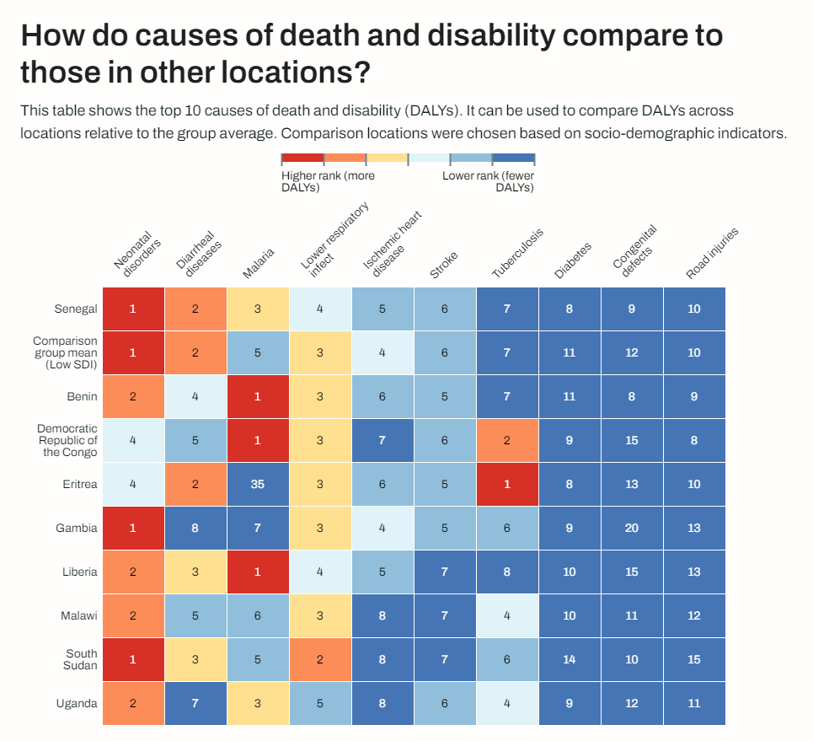
IHME Country Metrics
Amalgaland
Our results are very similar to those of our low-SDI peers.
Notes:
NOTE: IHME data for Senegal is used for this example

Slide 31
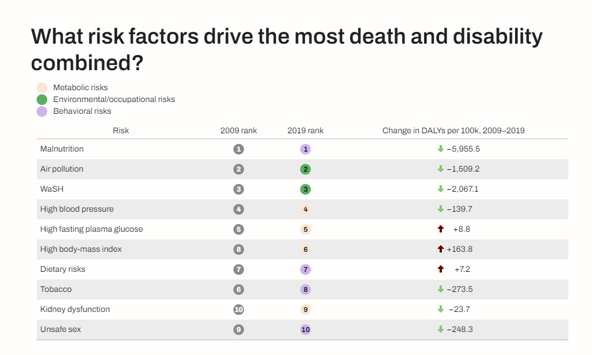
IHME Country Metrics
*
*
*
*
Many risks addressable through health interventions.
*
Notes:
NOTE: IHME data for Senegal is used for this example

Slide 32
Key takeaway points:
Over the next 50 years, the population will significantly age. Demographic “pyramid” -> “water tower”!
Solid progress has been made on addressing the communicable disease burden. Even so, it remains that six of the top 10 causes of lost DALYs are communicable, maternal, neonatal or dietary related.
The most rapidly increasing sources of lost DALYs are Ischemic Heart Disease and Stroke (both NCDs).
Many risk factors are addressable through health interventions.

Slide 34
Interaction 1.2
<paste Form link here>
Were you surprised at the top 10 DALYs? [yes, no]
What do you believe should be the top 2 care use cases supported by our national HIE? [prepare choice list of top 10 DALYs; other]
In what 2 areas do you believe we should focus regarding health system reportable indicators. [service availability; resource availability; care access/equity; service usage; care quality; health outcomes; costs; cost effectiveness; other]

Slide 35
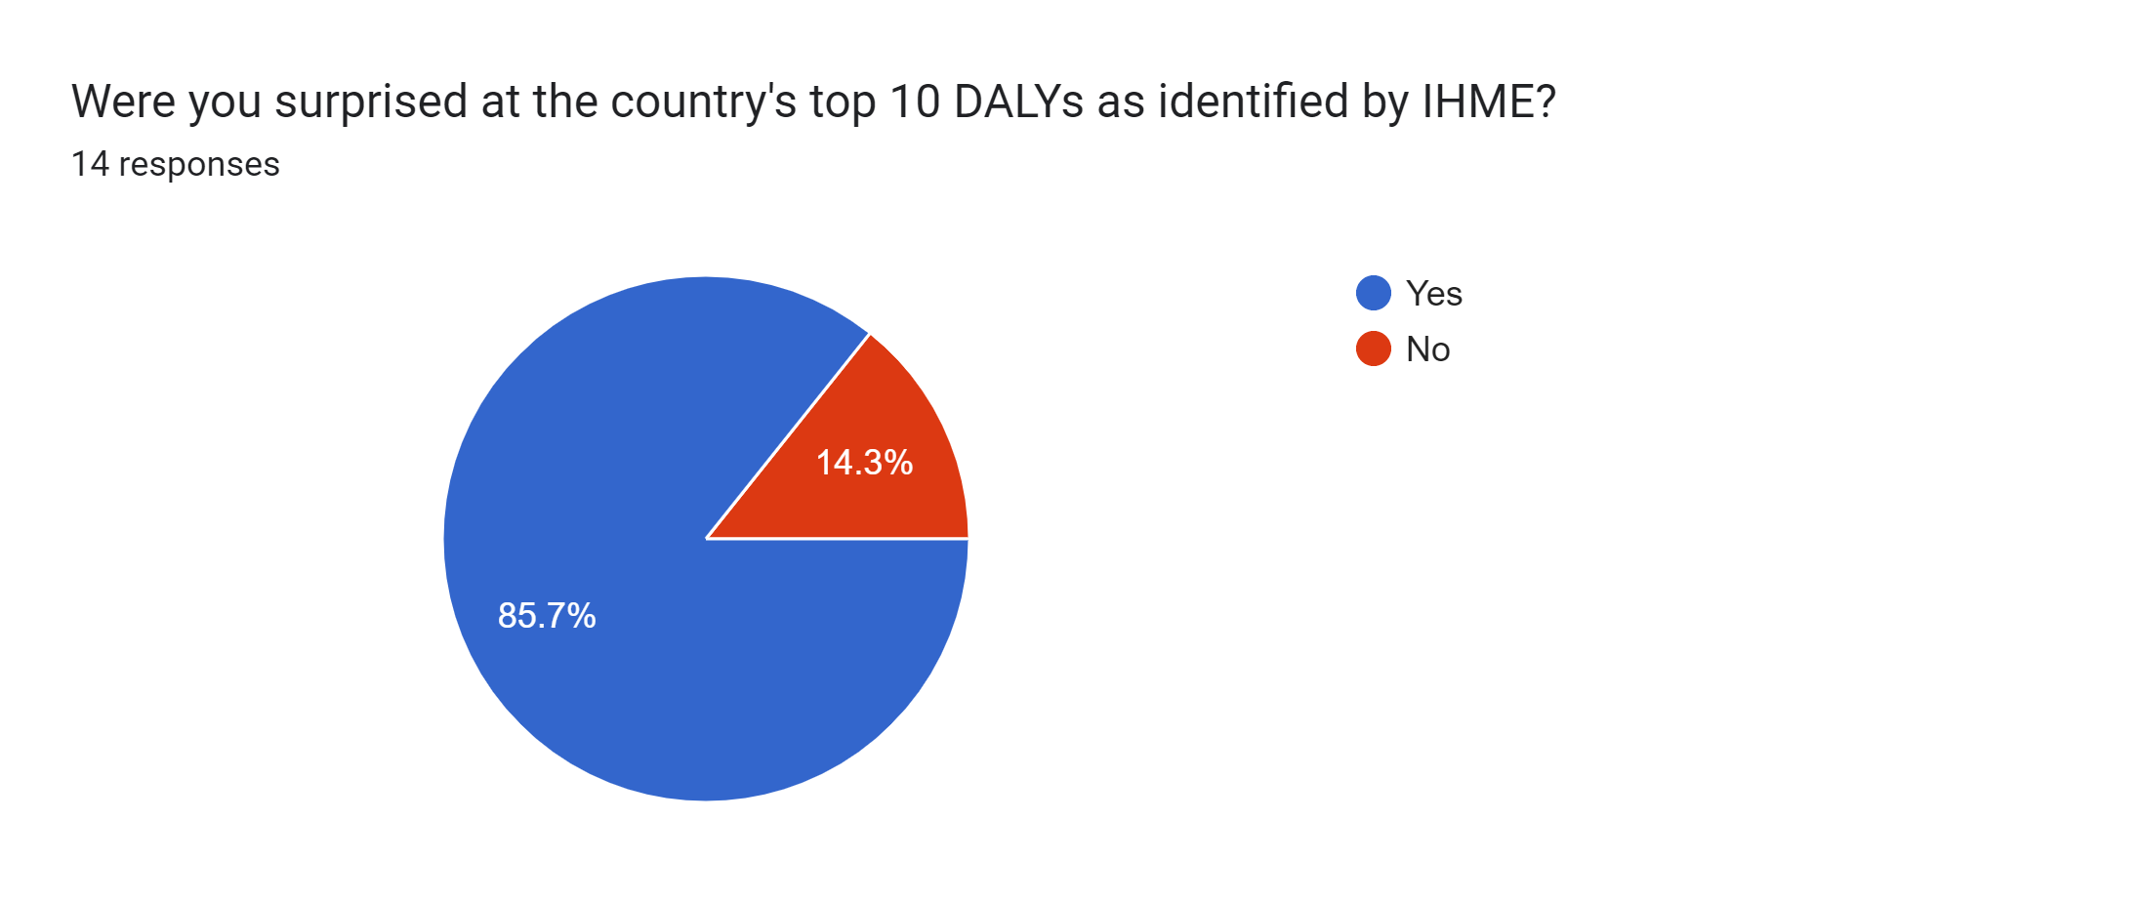
Interaction 1.2

Slide 36
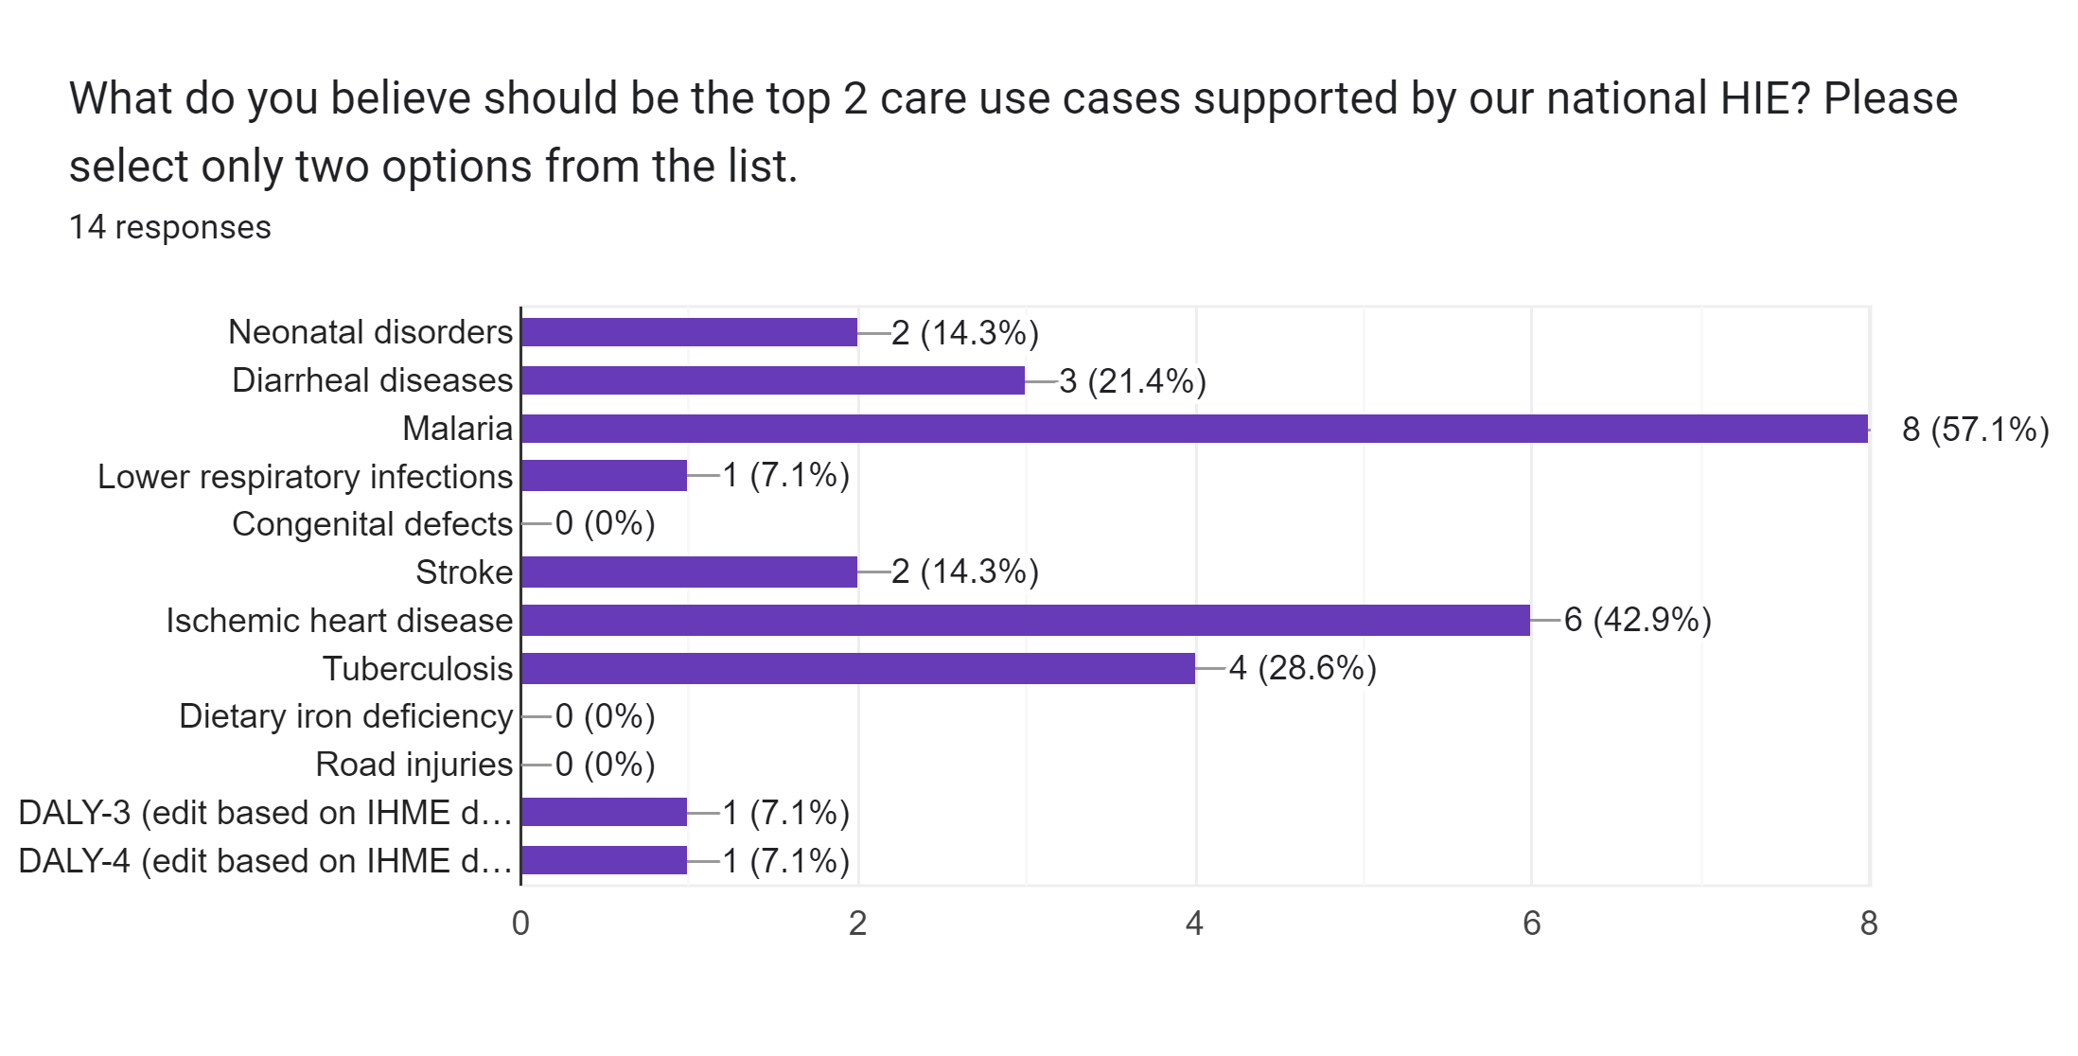
Interaction 1.2

Slide 37
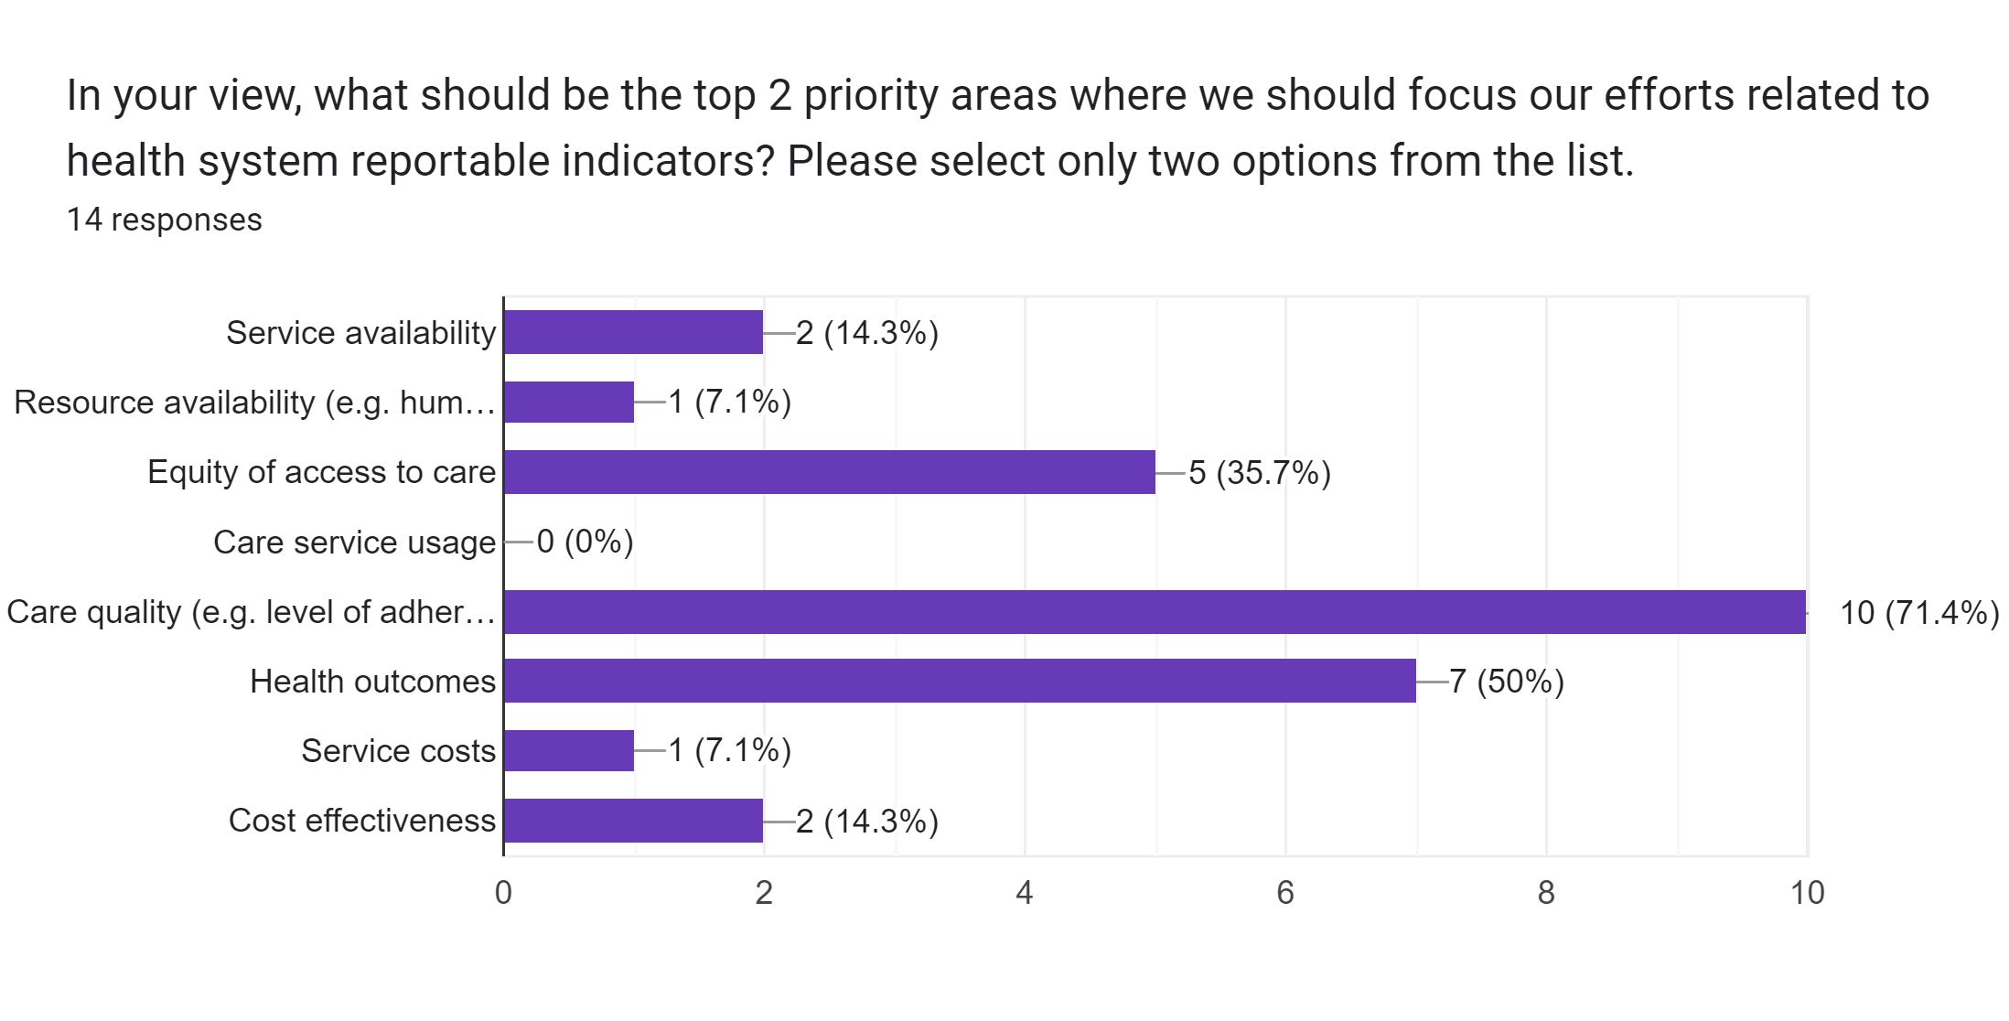
Interaction 1.2

Slide 38

COFFEE BREAK!
Notes:
Use this slide as a “break slide”

Slide 39
What are our current health and digital health strategies?

Slide 40

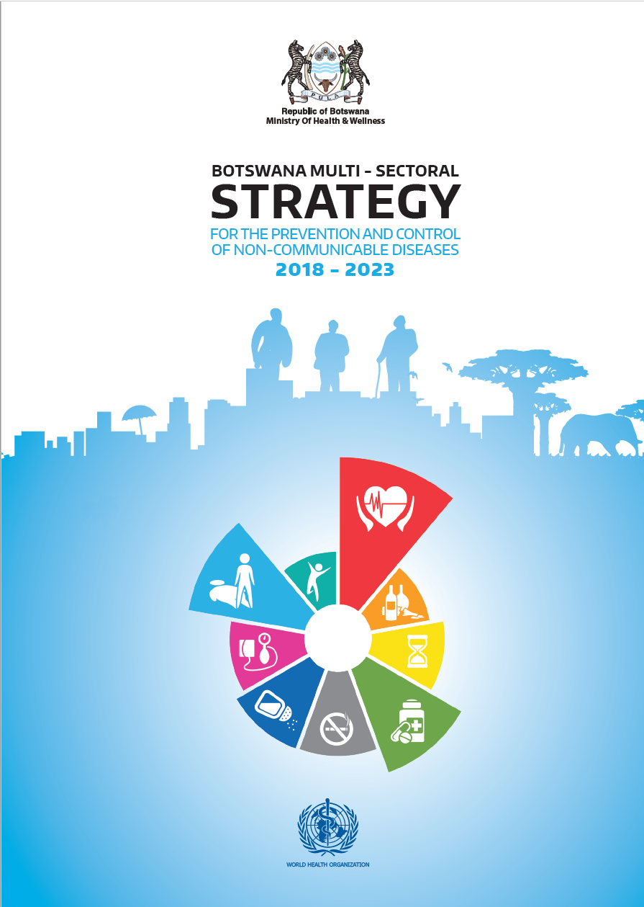
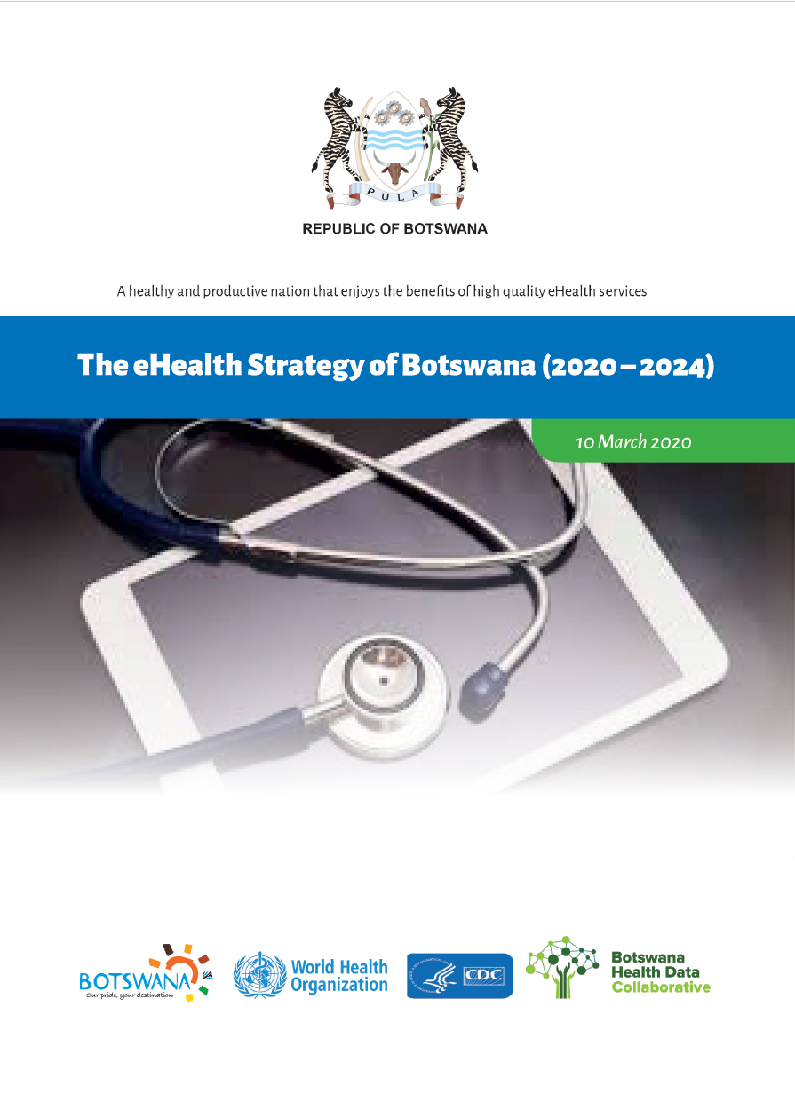
November 2010
January 2018
March 2020

Slide 41
“Health service delivery in the country is pluralistic. There are public, private for-profit, private non-profit, and traditional medicine practices. The Ministry of Health (MOH) is responsible for the formulation of policies, regulation and norms, and standards and guidelines for health services. Government has achieved the Abuja target of contributing 15% of total government expenditure to health (representing around 75% of total health expenditure). With the relocation of primary health care from the Ministry of Local Government (MLG), the MOH is now the principal public sector health care provider.”
“Health management information is weak. Challenges include untimely data collection, collation, analysis, interpretation, and dissemination of information. The situation in compounded by the existence of several databases (epidemiology, human resources, finance etc) existing in parallel. Monitoring and evaluation is fragmented; as a consequence, tracking health outcomes, and measuring the impact of specific interventions is compromised.”
November 2010

Slide 42
Objectives of the IHSP
“The goal of service delivery is the attainment of universal coverage of a high-quality package of essential health services, EHSP, through:
Scale up of utilisation of a well defined and comprehensive essential health service package;
Redefining existing service delivery levels and delineating types of health services for each of these levels of the health care to ensure continuity and harmonised referral and supervisory functions;
Increasing and strengthening partnerships with the private sector and NGOs
Community involvement to ensure effective demand for health services
Promoting community participation in the planning and delivery of health services.”
November 2010

Slide 43
Objectives of the IHSP
“The Health Information and Research goal is to create an enabling environment for efficient monitoring and evaluation of the implementation and achievements of the integrated health service plan and to provide the basis for evidence-based decision-making. The objectives are:
To collect and analyse health information about diseases, services, finances, health workforce, medicines and medical products, infrastructure and equipment from all stakeholders of the health sector.
To clarify the roles and functions of different stakeholders in data management in order to minimise duplication and maximise optimal utilization of resources
To ensure timely, wide, and need-based dissemination of data to all stakeholders.
To develop and implement a research agenda in collaboration with relevant partners to support national policy development
To develop and implement regulations regarding mandatory reporting of defined information requirements
To develop, implement and enforce regulatory mechanism for health research.”
November 2010

Slide 44
“This national strategy will focus on the four major NCDs, which account for 82% of NCD-related deaths (cancers, cardiovascular diseases, diabetes, chronic respiratory disease), as well as the four common modifiable risk factors they are associated with (smoking, harmful use of alcohol, unhealthy diet, and physical inactivity). Broader definitions of NCDs are recognised, including injuries and mental illness, as well as those conditions referred to in the Brazzaville Declaration (hemoglobinopathies, oral disease, eye disease, rheumatic heart disease). While these conditions are important, the approach taken in this strategy was to maintain a narrow focus in order to address the areas of highest burden and areas with the greatest gaps, and facilitate effective implementation of their ‘best buys’ interventions.”
Top-4 NCD causes of death from IHME (2021):
#3 Stroke
#5 Ischemic Heart Disease
#8 Diabetes
#10 Hypertensive Heart Disease
January 2018

Slide 45
“…[M]any individuals who have an NCD are undiagnosed and unaware of it. The STEPS 2014 survey revealed that 23% of those with hypertension were not aware and not on treatment. Furthermore, 70% of cancers reported nationally with staging information available are diagnosed at advanced stage. This limits the impact of treatment and the chances of long-term survival.”
January 2018

Slide 46
“The rising burden of NCDs in the country is of great concern to the Government of Botswana and is a threat to the achievement of the Sustainable Development Goals 2016-2030 and Vision 2036. The prevention and control of NCDs has been prioritised and included in high-level national strategy documents such as the 11th National Development Plan (2017-2023), Ministry of Health and Wellness strategy 2017-2023 and the National Essential Health Services package. NCD diagnosis and management has also been incorporated into the National Strategic Framework III for HIV/AIDS. Finally, a national harmonisation of community-based interventions in health is underway, which will include standardised basic NCD prevention and control services offered by community health workers.”
January 2018

Slide 47
March 2020

Slide 48
March 2020

Slide 49
Key takeaway points:
Botswana’s strategic health focus is broadening (since 2010) to address the growing NCD burden.
Driven by UHC goals, a package of basic health services has been defined, largely to be delivered in primary or community care settings.
More recently, the digital health focus has shifted from M&E-only toward broader support of care delivery workflows executed at the point of service.
Care continuity is recognized as important. Health data sharing infrastructure has been identified as a strategic initiative to help address it.
Botswana needs a national digital health “blueprint”, including national norms and standards.
Capacity is a limiter, and a key challenge to overcome.

Slide 51
Interaction 1.3
<paste Form link here>
How often do you believe our health strategy should be updated?
How often do you believe our digital health strategy should be updated?
How often do you believe our digital health blueprint should be updated?
Is our health strategy well aligned to addressing our national burden of disease?
Is our digital health strategy well aligned to our health strategy?
Is our digital health strategy well aligned to addressing our national burden of disease?
Would a national HIE well support our strategic goals?
Would a national HIE well address our disease burden?

Slide 52
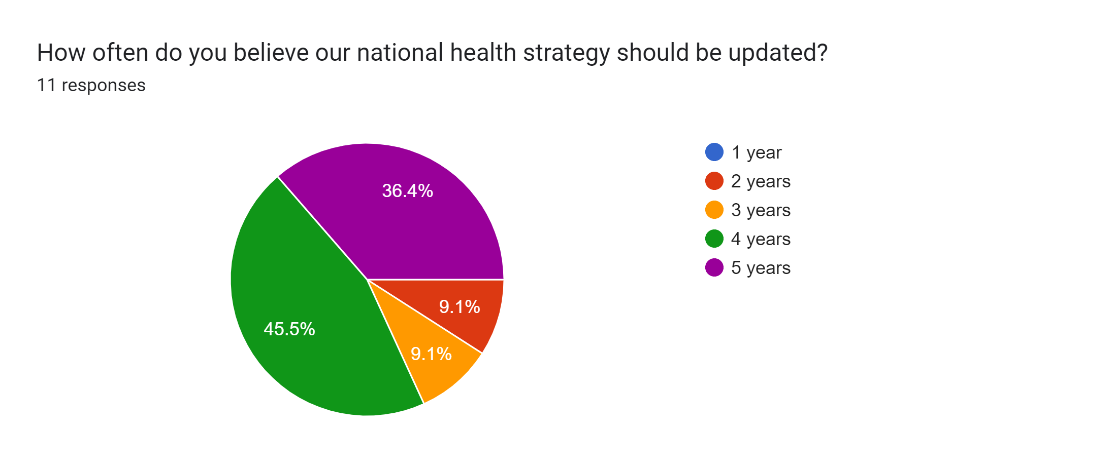
Interaction 1.3

Slide 53
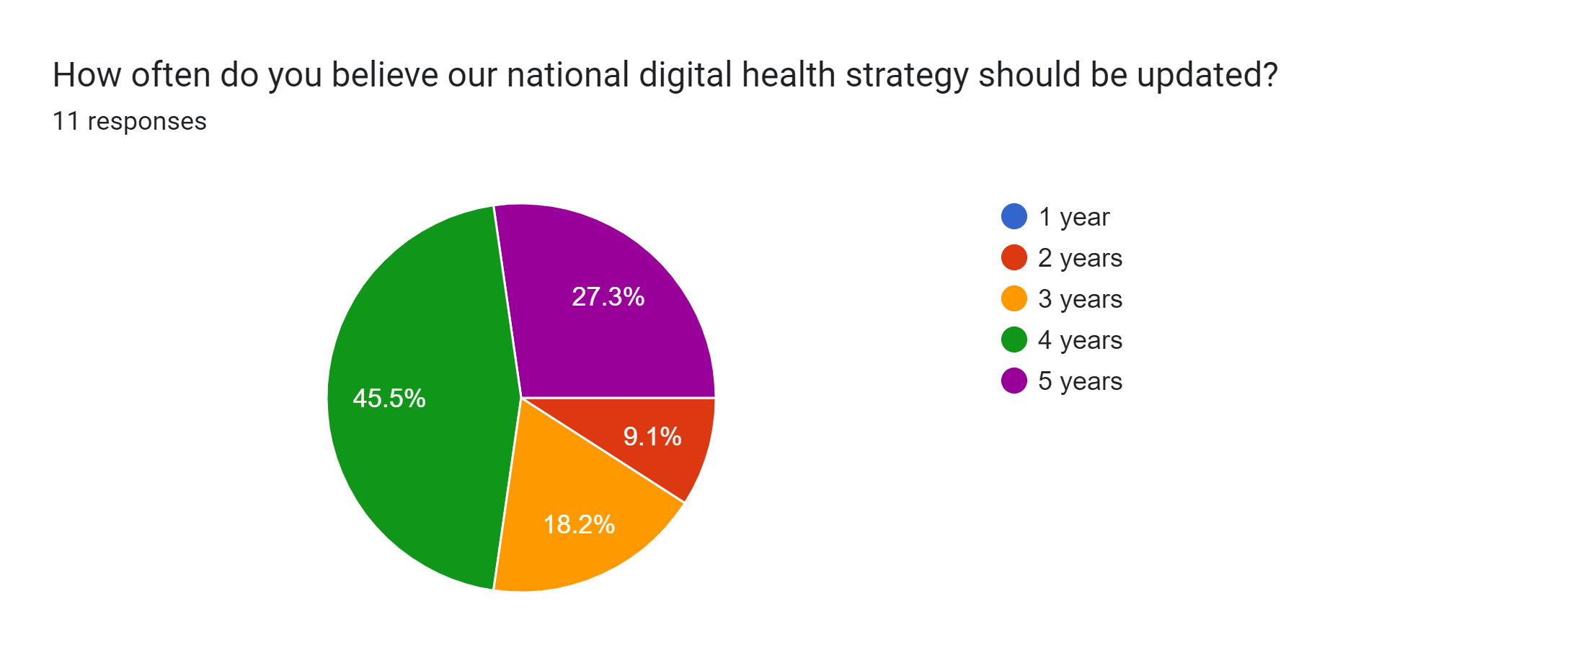
Interaction 1.3

Slide 54

Interaction 1.3

Slide 55

Interaction 1.3

Slide 56
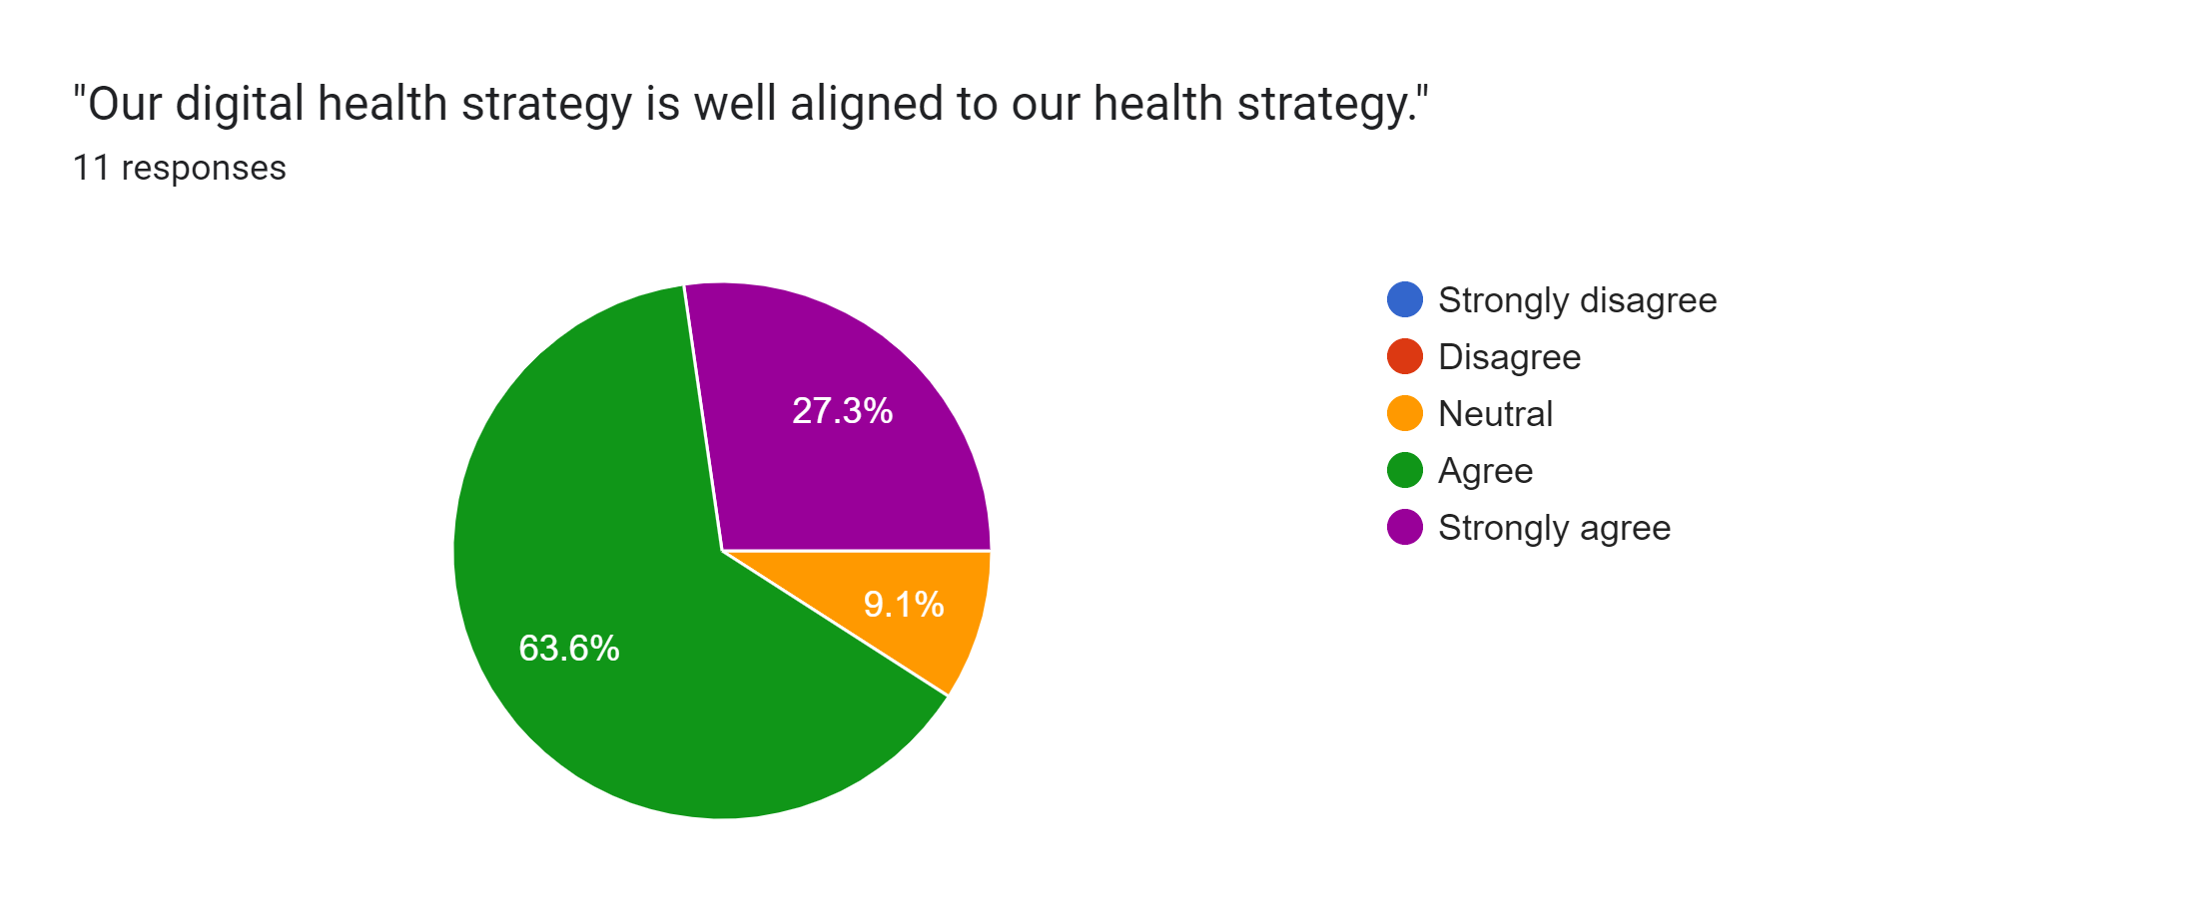
Interaction 1.3

Slide 57
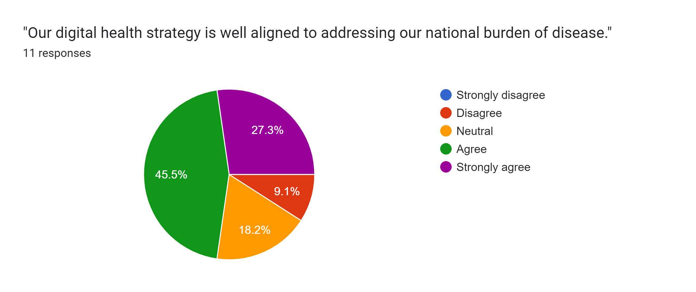
Interaction 1.3

Slide 58
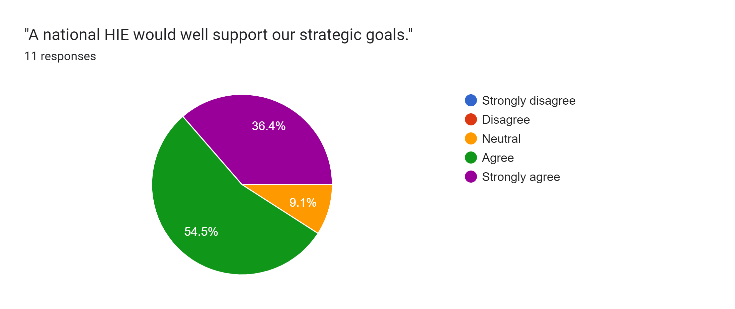
Interaction 1.3

Slide 59
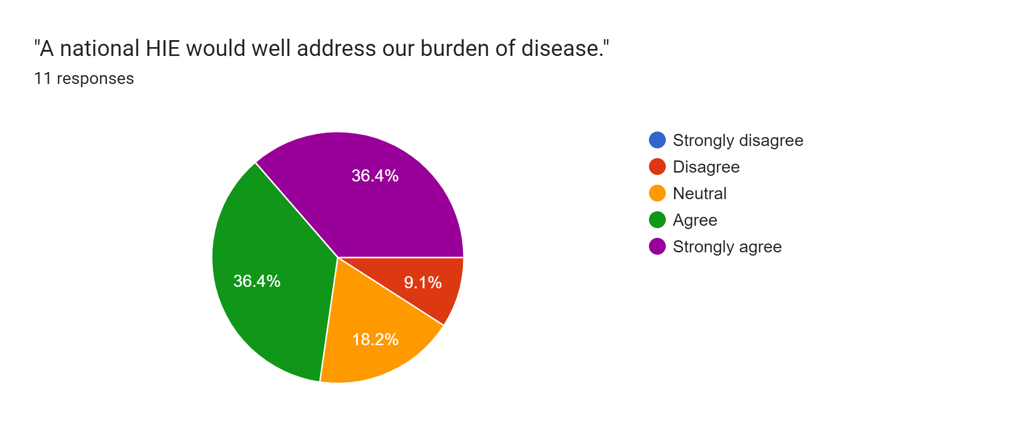
Interaction 1.3

Slide 60
How can digital health be leveraged to improve health?

Slide 61
Theory of change:
“We want to maximize the care delivered in the GREEN ZONE.”
Errors of
Omission
Everything that was done
The GREEN ZONE
Everything that should be done
Errors of Commission

Slide 62
How can digital health improve care?
For many diseases / conditions, normative bodies publish best-practice care guidelines.
Leveraging the HL7 FHIR® standard, these normative care guidelines can be expressed as conformance-testable Computable Care Guidelines (CCGs).
Reflecting on Interaction 1.2 – what guideline-based care workflows should we consider?

Slide 63

Level 1: Narrative
Level 2: Semi-structured
Level 3: Computable
Level 4: Operationalized
Notes:
The CCG life cycle goes through 4 levels of knowledge representation.

Slide 64
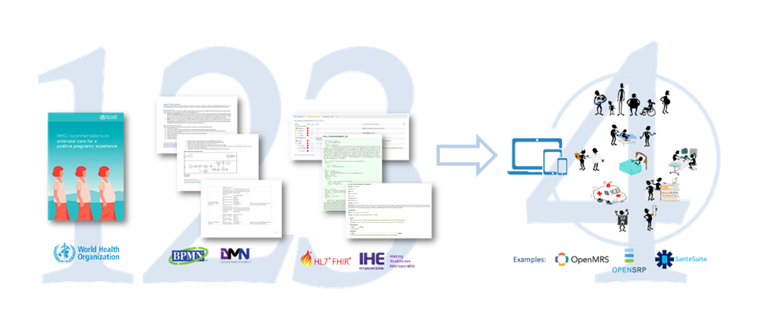
At Level 1 (or L1) are the narrative guidelines published by WHO or by normative national bodies such as the CDC or Diabetes Canada (as examples).
Notes:
At Level 1 (or L1) are the narrative guidelines published by WHO or by normative national bodies such as the CDC or Diabetes Canada (as examples).

Slide 65
Level 2 (L2) artefacts distill the narrative text into a set of personas, user stories, workflow diagrams (such as BPMN diagrams) and decision tables. WHO calls their L2 artefacts: Digital Adaptation Kits (DAKs).
Notes:
Level 2 artefacts distill the narrative text into a set of personas, user stories, workflow diagrams (such as BPMN diagrams) and decision tables. WHO calls their L2 artefacts: Digital Adaptation Kits.

Slide 66
At Level 3 (L3) are the CCGs themselves. These are FHIR packages that contain the collection of FHIR resources and libraries that define a machine-interpretable version of the care guideline.
Notes:
At Level 3 are the CCGs themselves. These are FHIR packages that contain the collection of FHIR resources and libraries that define a machine-interpretable version of the care guideline.

Slide 67
Finally, at Level 4 (L4), the L3 artefacts are ingested by and operationalized by digital health solutions across the entire care delivery network.
Notes:
Finally, at Level 4, the L3 artefacts are ingested by and operationalized by a digital health solution.

Slide 68

CCGs operationalize care quality, at scale.

Slide 69
CCG-supported care “activities”
Provide counselling
Record observations
Order tests
Record test results
Establish diagnosis
Order procedures
Provide procedures
Order medications
Dispense medications
Administer medications
Establish monitoring and follow-up (schedule next visit)
Refer (escalate care)

Slide 71
Interaction 1.4
<paste Form link here>
What functional activities are part of your 2 care use case workflows? Check all that apply. [list of health story activities; other]
What proportion of the care delivery network is, today, “digitally ready” for your 2 care use cases? [<20%, 20-40%, 40-60%, 60-80%, 80-100%]
How many years would it take us to be digitally ready across most (+80%) of our care network? [1,2,3,4,5, more than 5 years]

Slide 72
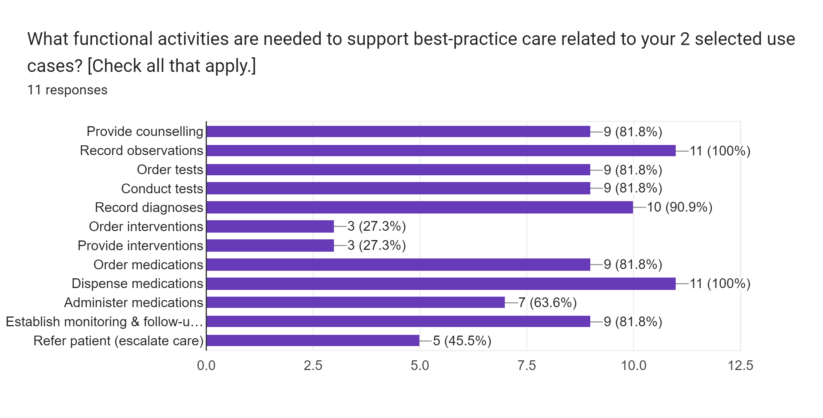
Interaction 1.4

Slide 73
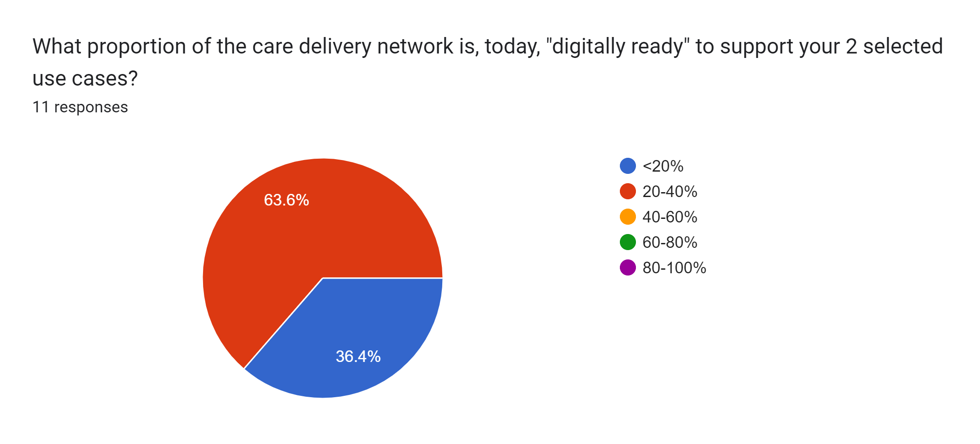
Interaction 1.4

Slide 74
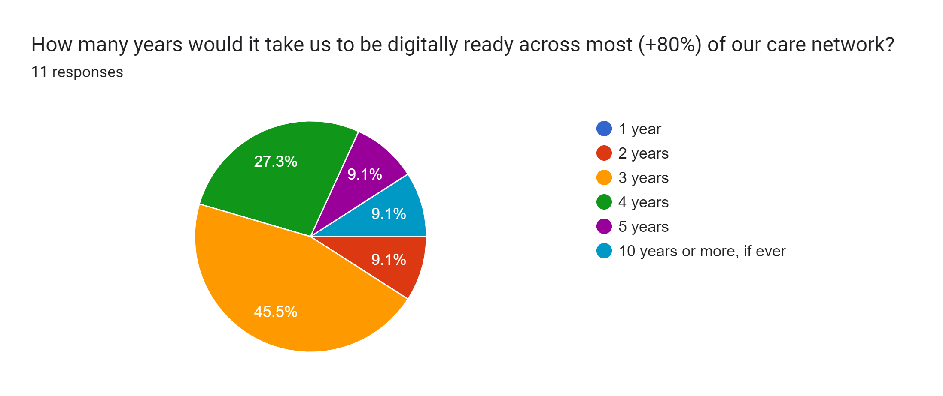
Interaction 1.4

Slide 75
Next steps: Workshop-2
Leverage existing digital health frameworks and standards to define the functional footprint of a national HIE infrastructure.
Explore HIE deployment models.
Establish the point of service (POS) solution requirements needed to support broad scaling of guideline-based care that addresses our national burden of disease.
Remember – you will need your PC, tablet, or smartphone to fill in the questionnaires.

